Slide 1

COM410 Programming in Practice
Algorithm Performance (Lab)

Slide 2


Reach Out
Email:
serif.salem@qa.com
Serif Refined Material (Password: COM410)
https://tinyurl.com/QACOM410
University Drop Box
https://tinyurl.com/QAULSTER

Slide 3
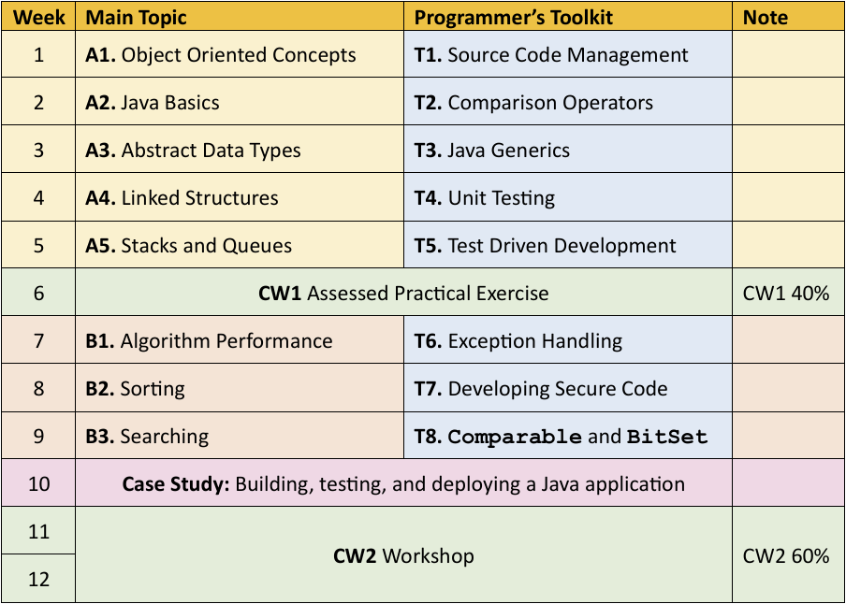
Module Structure and Assessment

Slide 4
Measuring Algorithm Performance

Slide 5
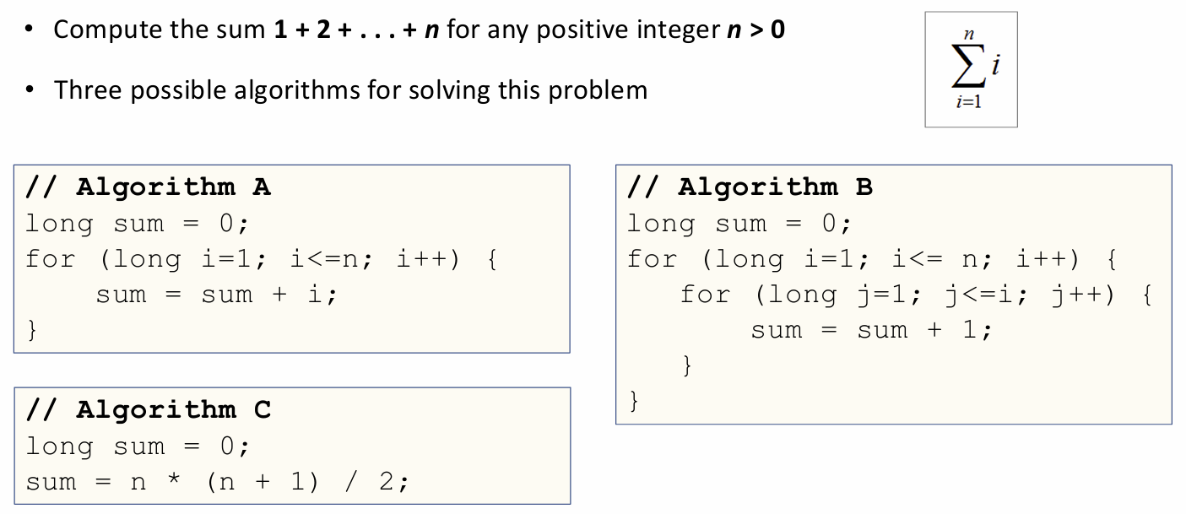
Example - Compute the Sum of Positive Integers

Slide 6
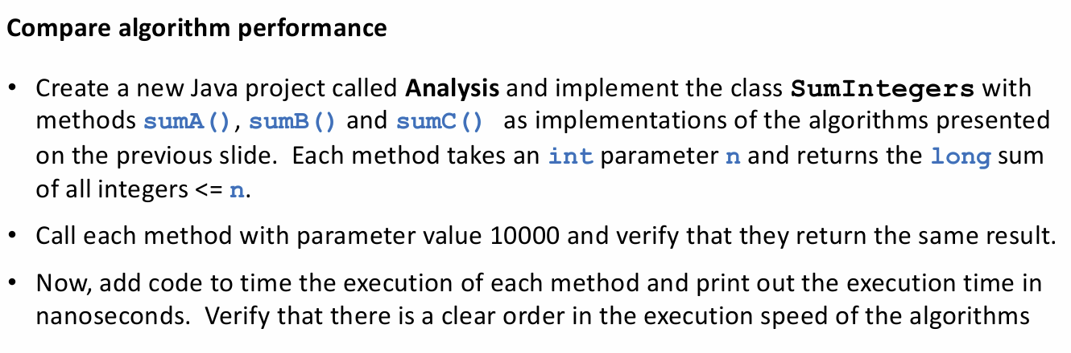
Scenario (Lab)

Slide 7
Project Structure
SumIntegers.java // Contains sumA(), sumB(), and sumC()
SumIntegers.sumA(n) – the method for Algorithm A
SumIntegers.sumB(n) – the method for Algorithm B
SumIntegers.sumC(n) – the method for Algorithm C
Task2.java // Verifies that all methods return the same result
Task3.java // Measures execution time for each method

Slide 8
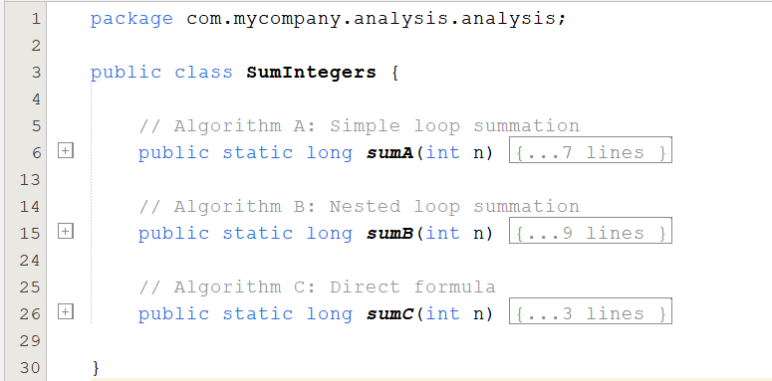
1. SumIntegers.java (Computation Class)
Create a new Java project called Analysis and implement the class SumIntegers with methods sumA(), sumB() and sumC() as implementations of the algorithms presented on the previous slide. Each method takes an int parameter n and returns the long sum of all integers <= n.

Slide 9
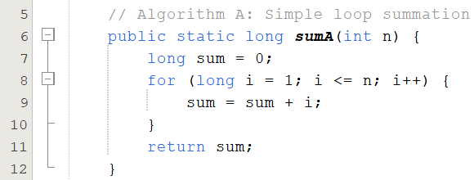
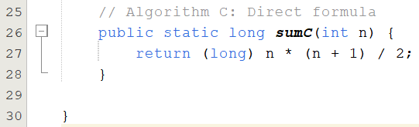
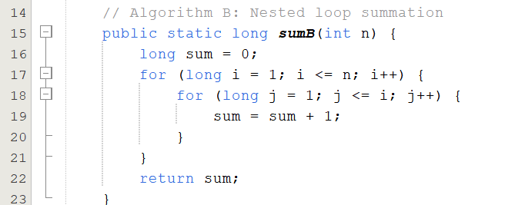
1. SumIntegers.java (Computation Class)

Slide 10
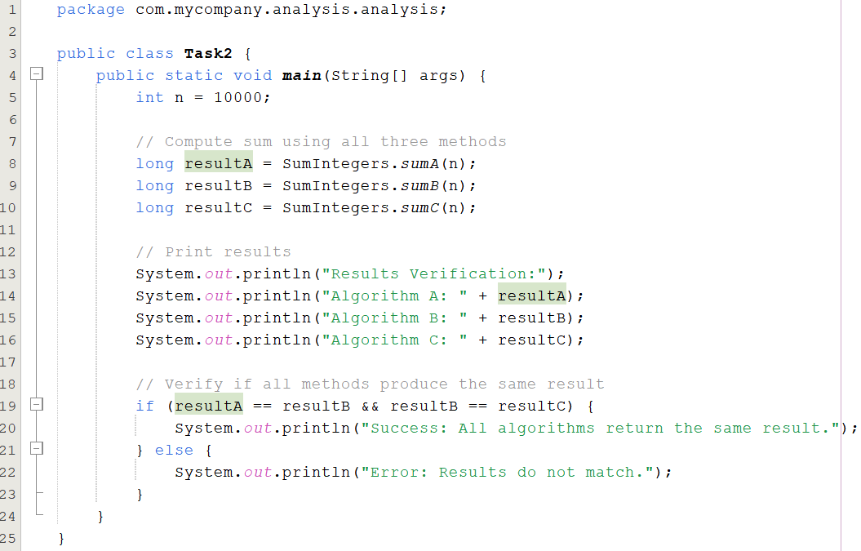
2. Task2.java (Verifies that all methods return the same result)
Call each method with parameter value 10000 and verify that they return the same result.

Slide 11
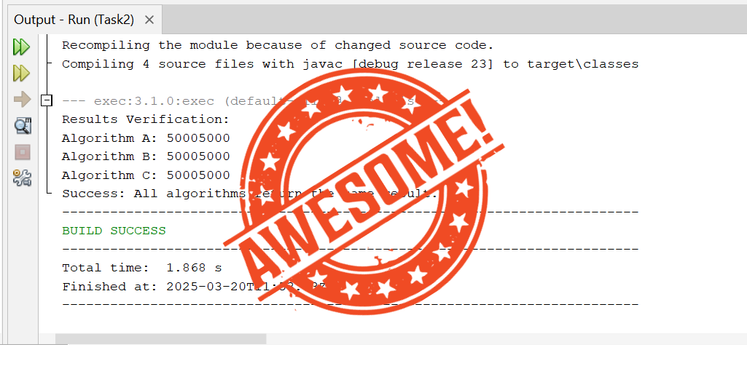
Output of Task 2

Slide 12
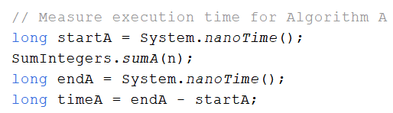
3. Task3.java (Measures execution times for each method)
Now, add code to time the execution of each method and print out the execution time in nanoseconds. Verify that there is a clear order in the execution speed of the algorithms
To add code to time the execution, we will use the System.nanoTime(), which is a static method in Java’s System class that returns the current time in nanoseconds.

Slide 13
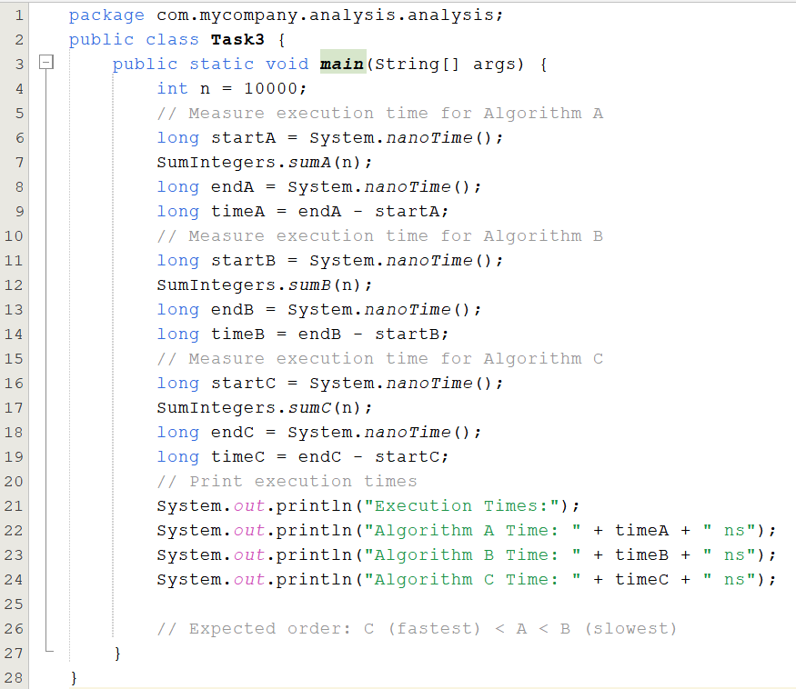
3. Task3.java (Measures execution times for each method)

Slide 14
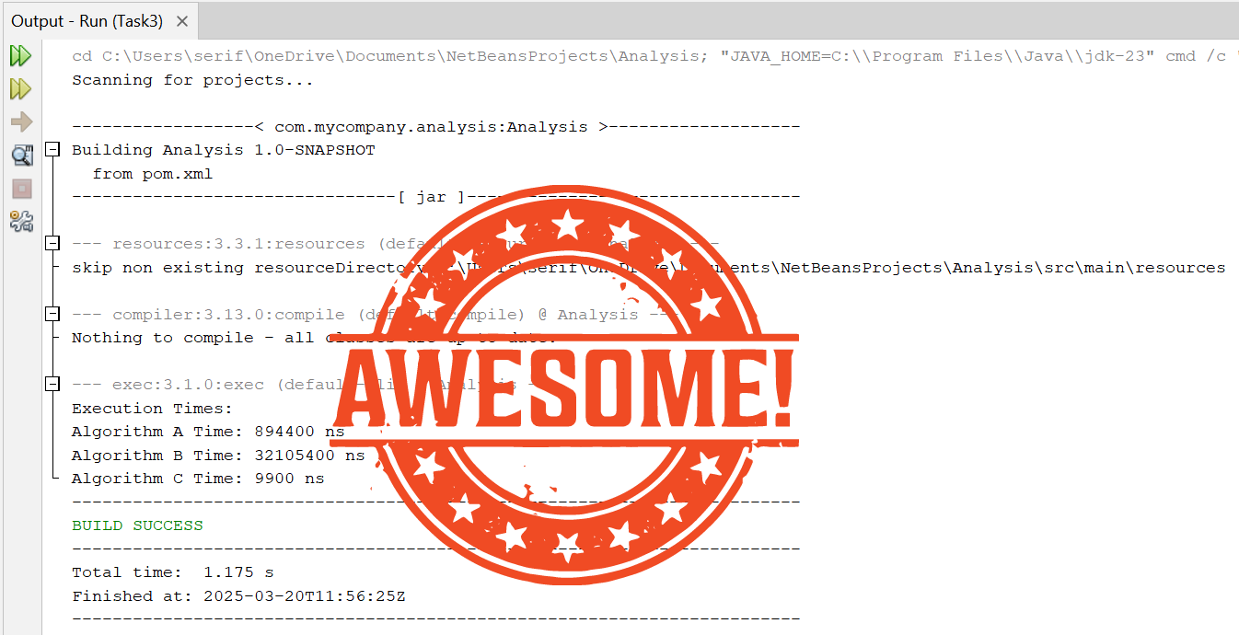
Output of Task 3

Slide 15
Counting Operations

Slide 16
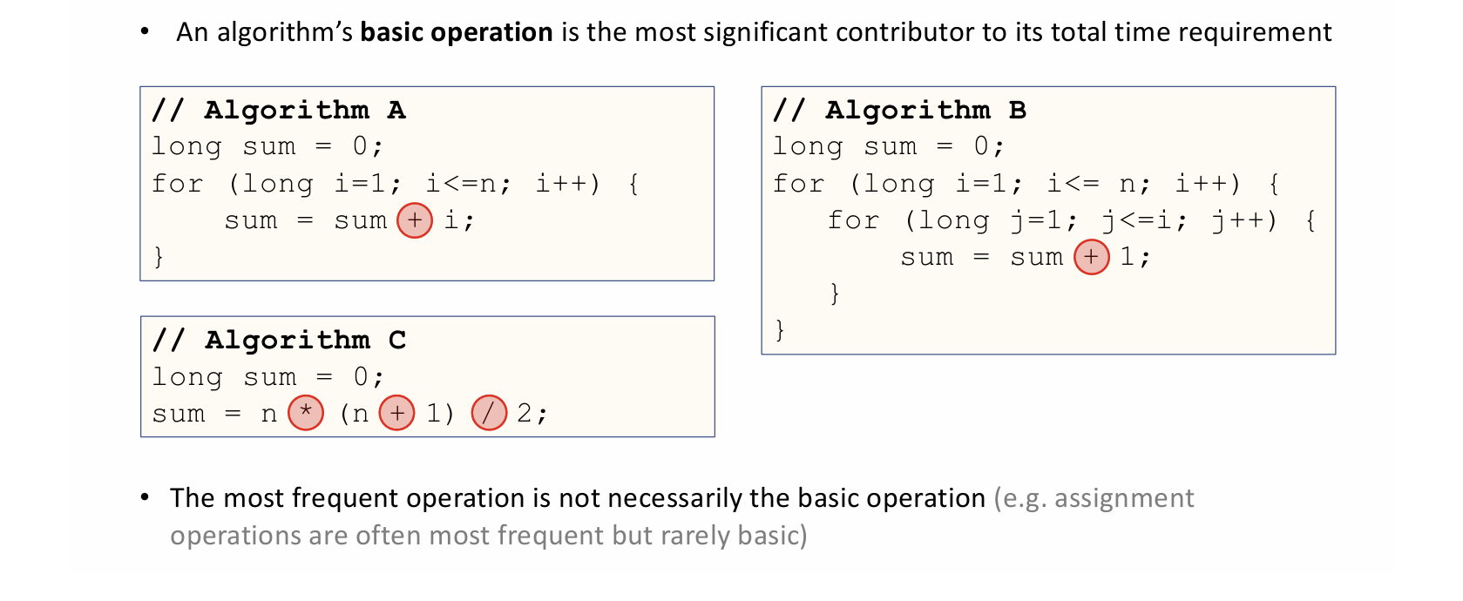
Counting Basic Operations
Number of basic operations: exactly n times.
Complexity: O(n).
Number of basic operations: Approx.. n² /2 times.
Complexity: O(n²).
Number of basic operations: exactly 3 times.
Complexity: O(1).

Slide 17
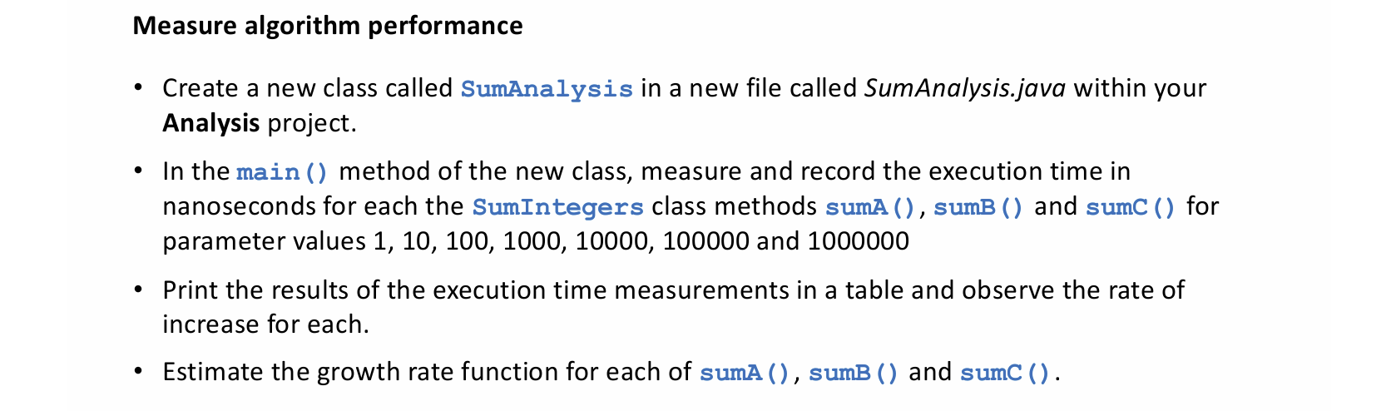
Scenario (Lab)

Slide 18
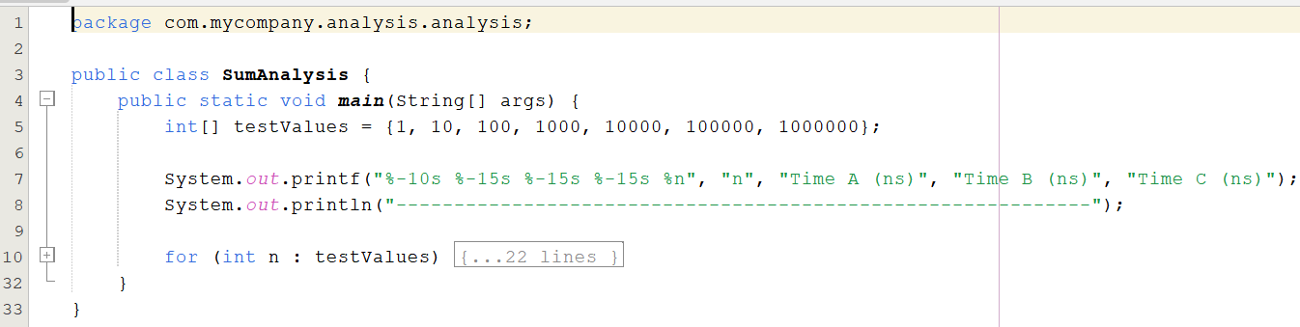
Create a new class called SumAnalysis
Create a new class called SumAnalysis in a new file called SumAnalysis.java within your Analysis project.

Slide 19
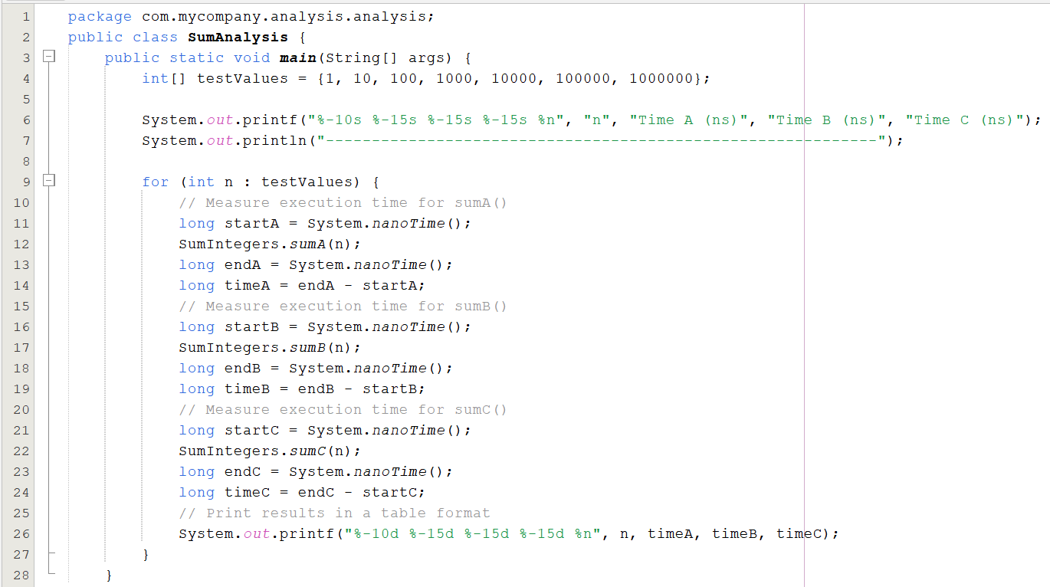

Slide 20
System.out.printf("%-10s %-15s %-15s %-15s %n", "n", "Time A (ns)", "Time B (ns)", "Time C (ns)");
Format String: %-10s %-15s %-15s %-15s %n
Code | Meaning
%-10s | Left-align (-) a string (s) in a 10-character-wide field.
%-15s | Left-align a string in a 15-character-wide field.
%-15s | Left-align a string in a 15-character-wide field.
%-15s | Left-align a string in a 15-character-wide field.
%n | Newline character, ensuring output moves to the next line.
"n", "Time A (ns)", "Time B (ns)", "Time C (ns)"
These are the column headers that will be printed in the formatted table.
n | Time A (ns) | Time B (ns) | Time C (ns)

Slide 21
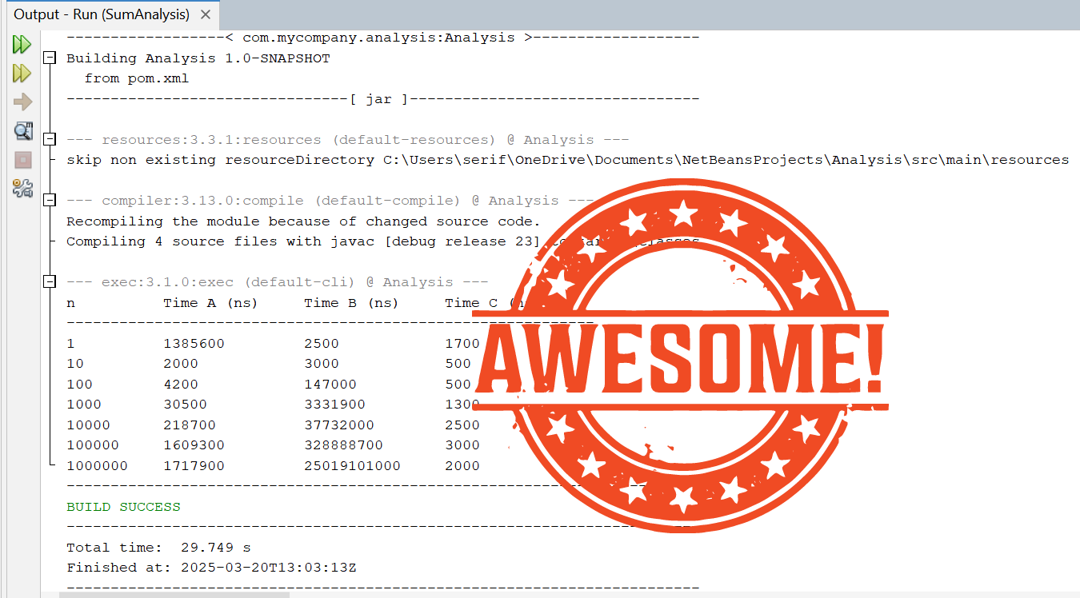

Slide 22
The Big O Notation

Slide 23
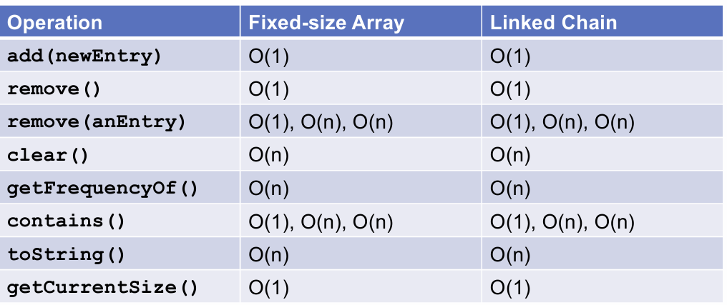
Efficiency of Implementations of Bag ADT
add(newEntry):
O(1) in both structures: Adding an element typically happens at the end, requiring constant time.
remove():
O(1) in both structures: Removing an element from a known position (often the end) requires constant time.
remove(anEntry):
Complexity varies (O(1), O(n), O(n)) because:
Best case (O(1)): removing the first or last element.
Average/Worst case (O(n)): removing from the middle, needing traversal.

Slide 24
clear():
O(n) in both structures: Requires traversal of every element, removing each individually.
getFrequencyOf():
O(n) in both structures: Needs to scan through the entire structure to count occurrences.
contains():
Complexity (O(1), O(n), O(n)) varies similarly:
Best case (O(1)): element found immediately (first element).
Average/Worst case (O(n)): need to traverse elements to find the entry.
toString():
O(n) for both structures: Converting to a string involves traversing all elements.
getCurrentSize():
O(1) for both structures: Typically, the structure stores its size, requiring just a single step to return it.

Slide 25
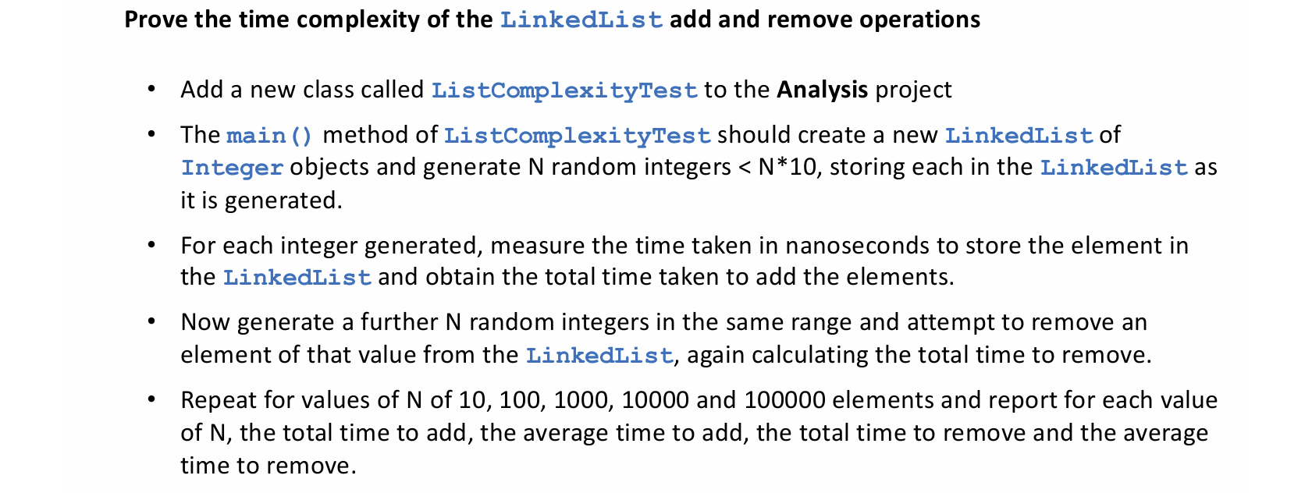
Challenge (Self Study)

